Slide 1

Final Project Semantic Segmentation on a Driving Dataset
Langchun Zhou
CSCI S-89 Introduction to Deep Learning
Summer 2022
Harvard Summer School

Slide 2
Introduction
Problem: given a picture of traffic, categorize each pixel of the picture as belonging to exactly one of multiple categories of traffic elements. This is an instance of semantic segmentation.
Motivation: to explore a deep-learning technique that will help to decrease the incidence and deadliness of traffic accidents through implementation in self-driving cars.
Semantic segmentation: categorize each pixel of an image as belonging to exactly one of multiple categories of elements that compose the image.
Image-wise, this makes semantic segmentation a prediction task.
Pixel-wise, this makes semantic segmentation a classification task.
“Because we’re predicting for every pixel in the image, this task is commonly referred to as dense prediction” (Jordan, 2018).

Slide 3
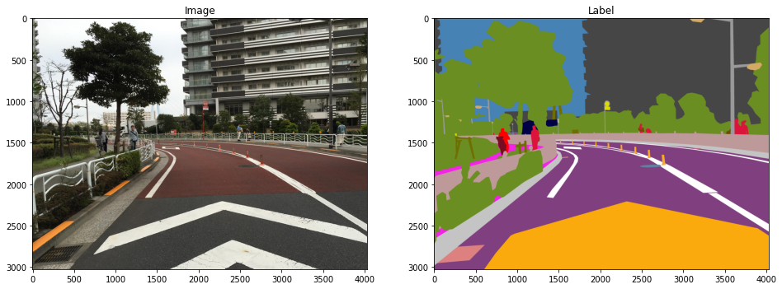
Dataset
Dataset: Mapillary Vistas.
Images: street-level JPGs.
Labels: PNGs. For each PNG, each pixel is categorized with a color that maps to the category of traffic element that pixel composes.

Slide 4
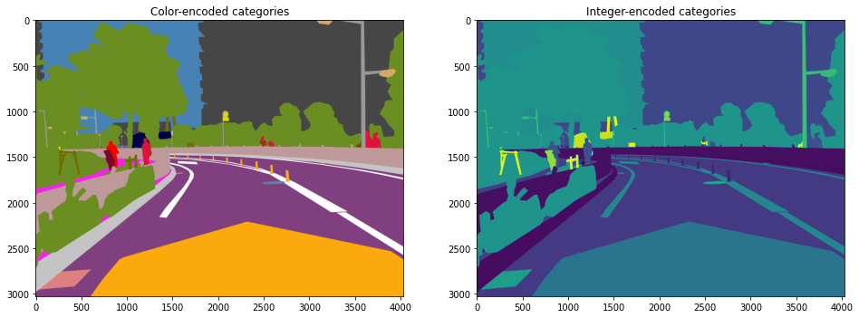
Preprocessing
Preprocessing: to reduce training times, images and labels were sampled from the full dataset and downsized. The sampled labels were also converted from color-encoding to integer-encoding, represented as grayscale PNGs.
# sampled training images & labels: 900
# sampled validation images & labels: 100
# sampled test images: 100
New image size: 512px ✕ 512px

Slide 5
Autoencoder
Naive approach: stack convolutional layers with “same” padding to produce a label of resolution equal to that of the input image.
Problem: computation cost
Solution: convolutional autoencoder
num_features_0 = 4
input_shape = (input_width, input_height, 3)
encoder = models.Sequential()
encoder.add(layers.Conv2D(num_features_0, kernel_size=3, padding='same',
activation='relu', input_shape=(input_shape)))
encoder.add(layers.MaxPool2D(pool_size=2))
encoder.add(layers.Conv2D(num_features_0 * 2, kernel_size=3,
padding='same', activation='relu'))
encoder.add(layers.MaxPool2D(pool_size=2))
encoder.add(layers.Conv2D(num_features_0 * 4, kernel_size=3,
padding='same', activation='relu'))
encoder.add(layers.MaxPool2D(pool_size=2))

Slide 6
Autoencoder
decoder = models.Sequential()
decoder.add(layers.Conv2DTranspose(
num_features_0 * 2,
kernel_size=3,
strides=2,
padding='same',
activation='relu',
input_shape=(input_width // 8, input_height // 8, num_features_0 * 4)))
decoder.add(layers.Conv2DTranspose(num_features_0, kernel_size=3,
strides=2, padding='same', activation='relu'))
decoder.add(layers.Conv2DTranspose(num_categories, kernel_size=3,
strides=2, padding='same', activation='softmax'))
autoencoder = models.Sequential([encoder, decoder])
autoencoder.compile(loss='sparse_categorical_crossentropy',
optimizer=optimizers.Adam())

Slide 7
Autoencoder
Model: "sequential_2"
_________________________________________________________________
Layer (type) Output Shape Param #
=================================================================
sequential (Sequential) (None, 64, 64, 16) 1576
sequential_1 (Sequential) (None, 512, 512, 124) 6040
=================================================================
Total params: 7,616
Trainable params: 7,616
Non-trainable params: 0
_________________________________________________________________
# pooling layers (pool_size=2): 3
# coding features: 16
# traffic element categories: 124

Slide 8
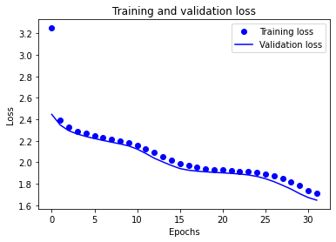
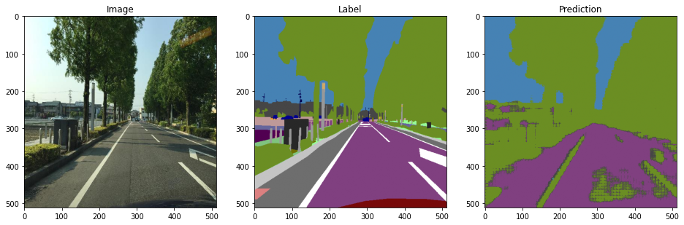
Autoencoder
Problem: too much information lost during downsampling (pooling)

Slide 9
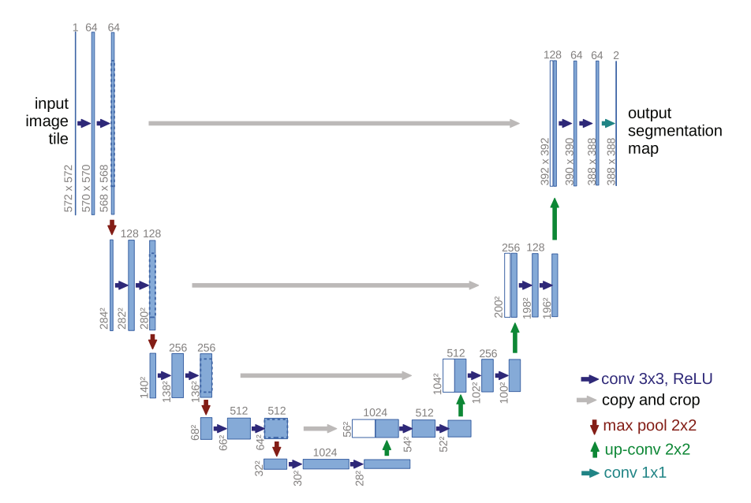
U-Net
Problem: too much information lost during downsampling (pooling)
Solution: add skips from encodings to decoders
Motivation: retain information from before downsamplings
Implementation: U-Net
(Ronneberger et al., 2015, p.235)

Slide 10
U-Net
def convolve(my_input, num_features):
conv_1 = layers.Conv2D(num_features, kernel_size=3, activation='relu',
padding='same')(my_input)
conv_2 = layers.Conv2D(num_features, kernel_size=3, activation='relu',
padding='same')(conv_1)
return conv_2
def encode(my_input, num_features):
encoding = convolve(my_input, num_features)
pool = layers.MaxPool2D(2)(encoding)
return encoding, pool
def decode(my_input, skip, num_features):
upsample = layers.Conv2DTranspose(num_features, kernel_size=2,
strides=2, padding='same')(my_input)
concat = layers.Concatenate()([upsample, skip])
out = convolve(concat, num_features)
return out

Slide 11
U-Net
def get_unet():
my_input = keras.Input(input_shape)
skip_1, encoding_1 = encode(my_input, 4)
skip_2, encoding_2 = encode(encoding_1, 8)
skip_3, encoding_3 = encode(encoding_2, 16)
skip_4, encoding_4 = encode(encoding_3, 32)
convolution = convolve(encoding_4, 64)
decoding_1 = decode(convolution, skip_4, 32)
decoding_2 = decode(decoding_1, skip_3, 16)
decoding_3 = decode(decoding_2, skip_2, 8)
decoding_4 = decode(decoding_3, skip_1, 4)
out = layers.Conv2D(num_categories, kernel_size=1, padding='same',
activation='softmax')(decoding_4)
model = keras.Model(my_input, out)
return model
Code inspiration: Bharath K., 2021.

Slide 12
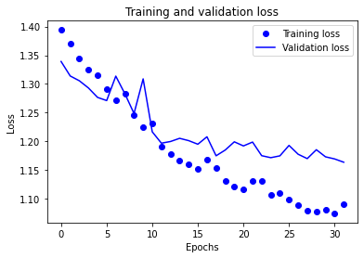
Autoencoder vs. U-Net
Autoencoder
U-Net
Validation loss: 2.4 to 1.7 over 32 epochs
Validation loss: 1.34 to 1.18 over 32 epochs

Slide 13
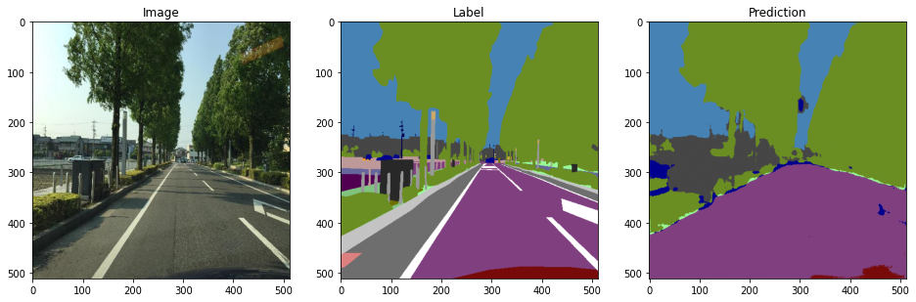
Autoencoder vs. U-Net
Autoencoder
Detecting only foliage, drivable area, sky
Artifacts from downsampling/upsampling
U-Net
Also detecting car hood, other cars (some false positives, misclassifications)
No artifacts

Slide 14
References
Jordan, J. (2018, 21 May). An overview of semantic image segmentation. Jeremy
Jordan. Retrieved August 5, 2022 from
https://www.jeremyjordan.me/semantic-segmentation/
K., Bharath. (2021). U-Net Architecture For Image Segmentation. PaperspaceBlog.
Retrieved August 5, 2022 from
https://blog.paperspace.com/unet-architecture-image-segmentation/.
Neuhold, G., Ollmann, T., Rota Buló, S., & Kontscheider, P. (2017). The Mapillary Vistas
Dataset for Semantic Understanding of Street Scenes. Mapillary. Retrieved August
5, 2022 from https://www.mapillary.com/dataset/vistas
Ronneberger, O., Fischer, P., Brox, T. (2015). U-Net: Convolutional Networks for
Biomedical Image Segmentation. In: Navab, N., Hornegger, J., Wells, W., Frangi, A.
(eds) Medical Image Computing and Computer-Assisted Intervention – MICCAI
2015. MICCAI 2015. Lecture Notes in Computer Science(), vol 9351. Springer,
Cham. Retrieved August 5, 2022 from
https://doi.org/10.1007/978-3-319-24574-4_28

Slide 15
YouTube Video Presentation
YouTube video presentation: https://youtu.be/bUL0zC7l4xc

